Slide 1
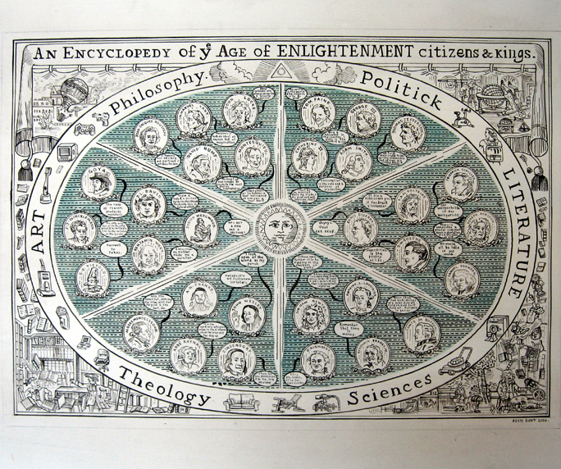
OntoCaptcha
A tool for mass participation…
… in ontology alignment!
A. Antonini, M. Fiorelli, M. Fumagalli, L. Humphreys, T. Tang – Tutor: J. Euzenat
Notes:
The same domain of knowledge can be represented with different ontologies
Ontology matching is the task of finding correspondences between two given ontologies, o and o^{1,} returning an alignment A
Finding these correspondences means finding relationship between classes of different ontologies.
A tomato is a fruit or a vegetable?

Slide 2
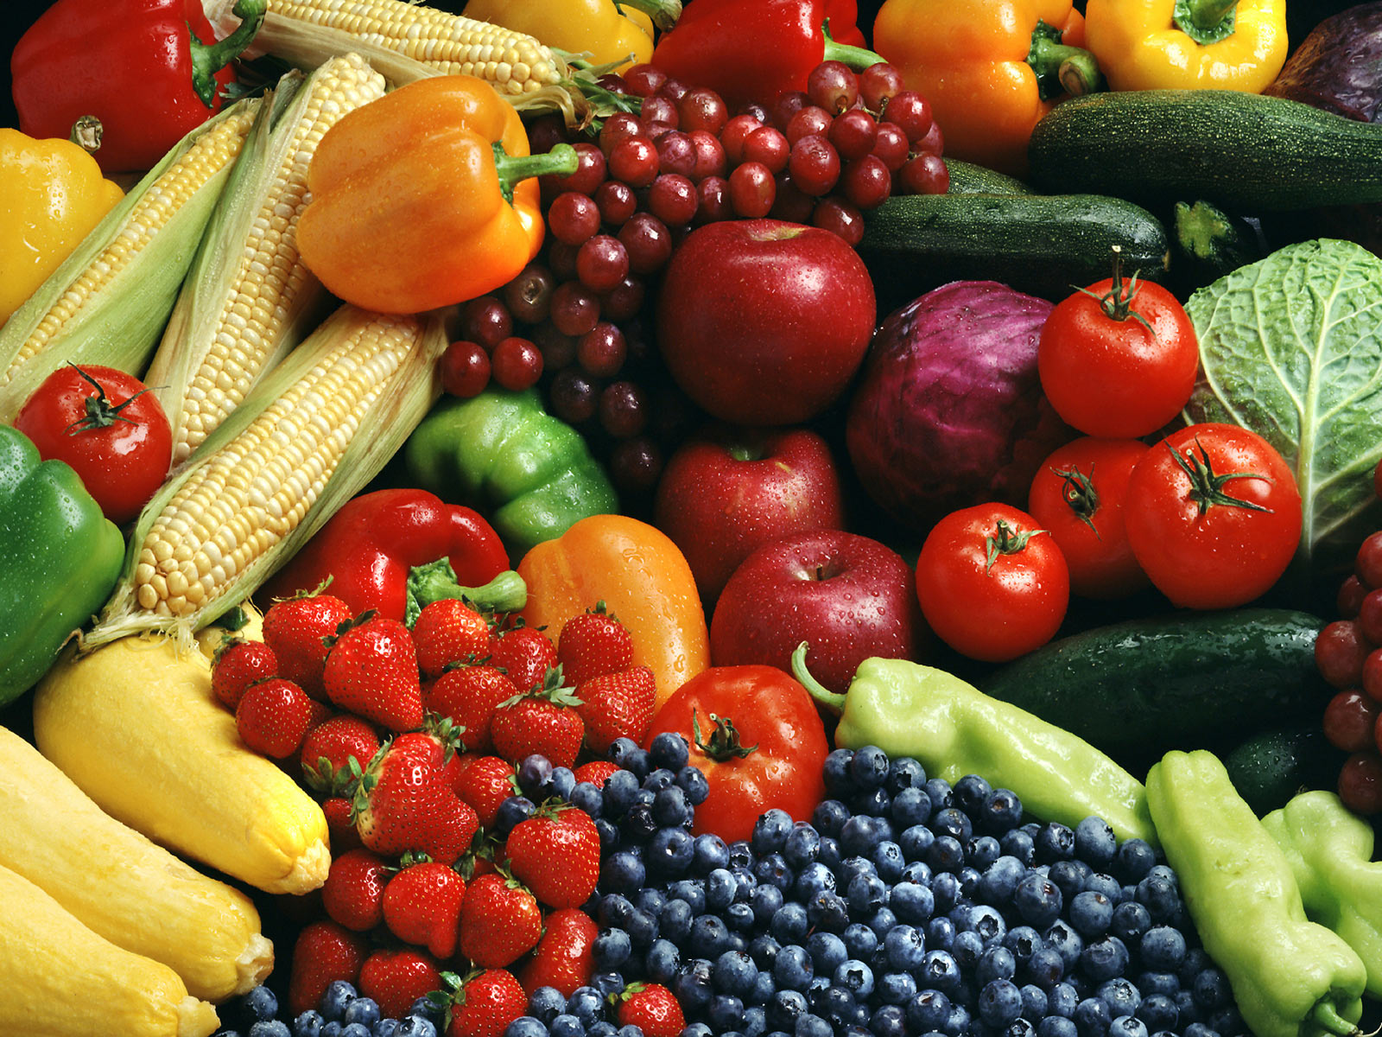
Research question
Problem: involving people in ontology matching
Solution:
- design a captcha tool
- offering simple reclassification tasks
- generated from linked data
- allowing for inferring relations between classes
Notes:
The same domain of knowledge can be represented with different ontologies
Ontology matching is the task of finding correspondences between two given ontologies, o and o^{1,} returning an alignment A
Finding these correspondences means finding relationship between classes of different ontologies.
A tomato is a fruit or a vegetable?

Slide 3
Research question
We have different ontologies for the same domain of knowledge
How to find correspondences between ontologies?
Is a tomato a fruit or a vegetable?
Notes:
The same domain of knowledge can be represented with different ontologies
Ontology matching is the task of finding correspondences between two given ontologies, o and o^{1,} returning an alignment A
Finding these correspondences means finding relationship between classes of different ontologies.
A tomato is a fruit or a vegetable?

Slide 4
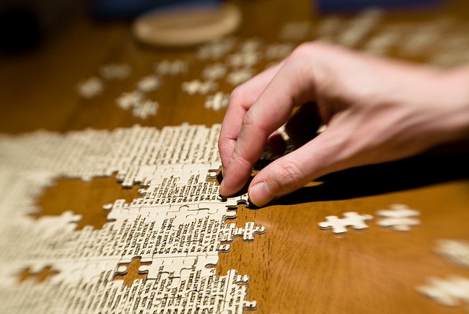
What we have now
Ontology matching needs human contributions
How to match ontology with human contributions?
CrowdMap: Crowdsourcing Ontology Alignment with Microtasks
Notes:
We have a wide variety of automatic methods to discover correspondences between ontologies but human contribution remain the key ingredient of the process.
Currently CrowdMap is the state of the art in collecting human contributions for ontology alignment tasks
This model acquire such human contributions via microtasks crowdsourcing (where crowdsourcing is the fact of submitting task to a platform that will be performed by a pool of Human users)

Slide 5

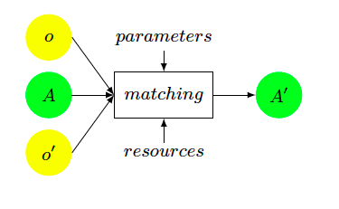
The Framework
Finding correspondences between two given ontologies, o and o¹, returning an alignment (A¹), collecting human contributions with microtasks

Slide 6
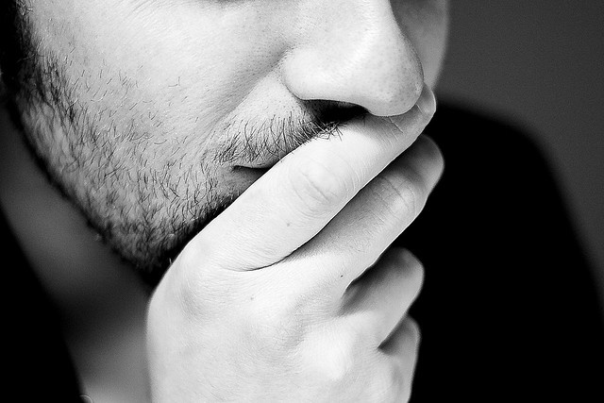
But…
Finding humans who perform tasks is a hard challenge
They need incentives.
Mechanical Turk: need money…
Game with a purpose: need to be engaging…
Notes:
Finding human users who perform tasks on a platform is an hard challenge
Usually users need an incentive for performing such works (i.e. monetary, see Amazon Mechanical Turk) and this limits the opportunities of collecting data (research does not have money ☺)
No money, no game developer > need to be clever

Slide 7
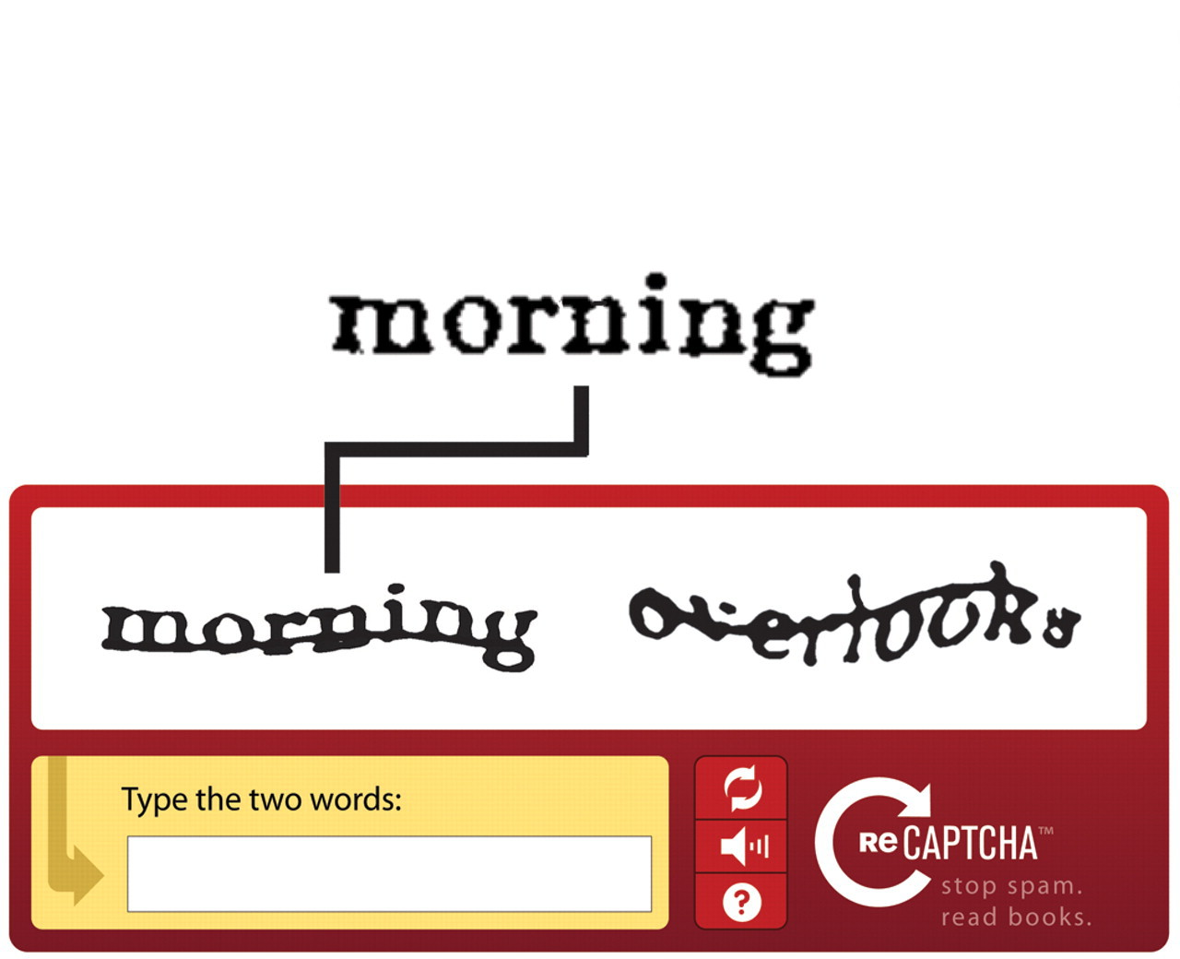
Our Proposal: Access Control Service
Data for free!
Large amount of information!
Sustainable process!
Attractiveness provided by clients!

Slide 8
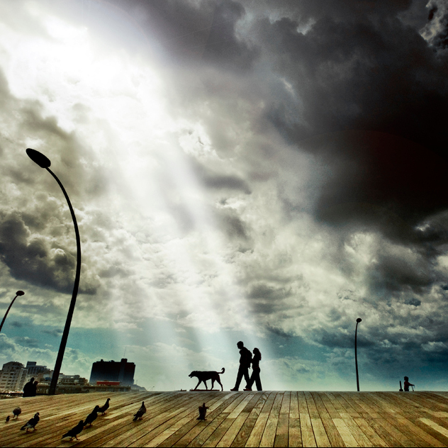
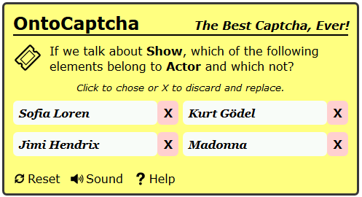
Our Proposal: OntoCaptcha
Notes:
Finding human users who perform tasks on a platform is an hard challenge
Usually users need an incentive for performing such works (i.e. monetary, see Amazon Mechanical Turk) and this limits the opportunities of collecting data (research does not have money ☺)
No money, no game developer > need to be clever

Slide 9
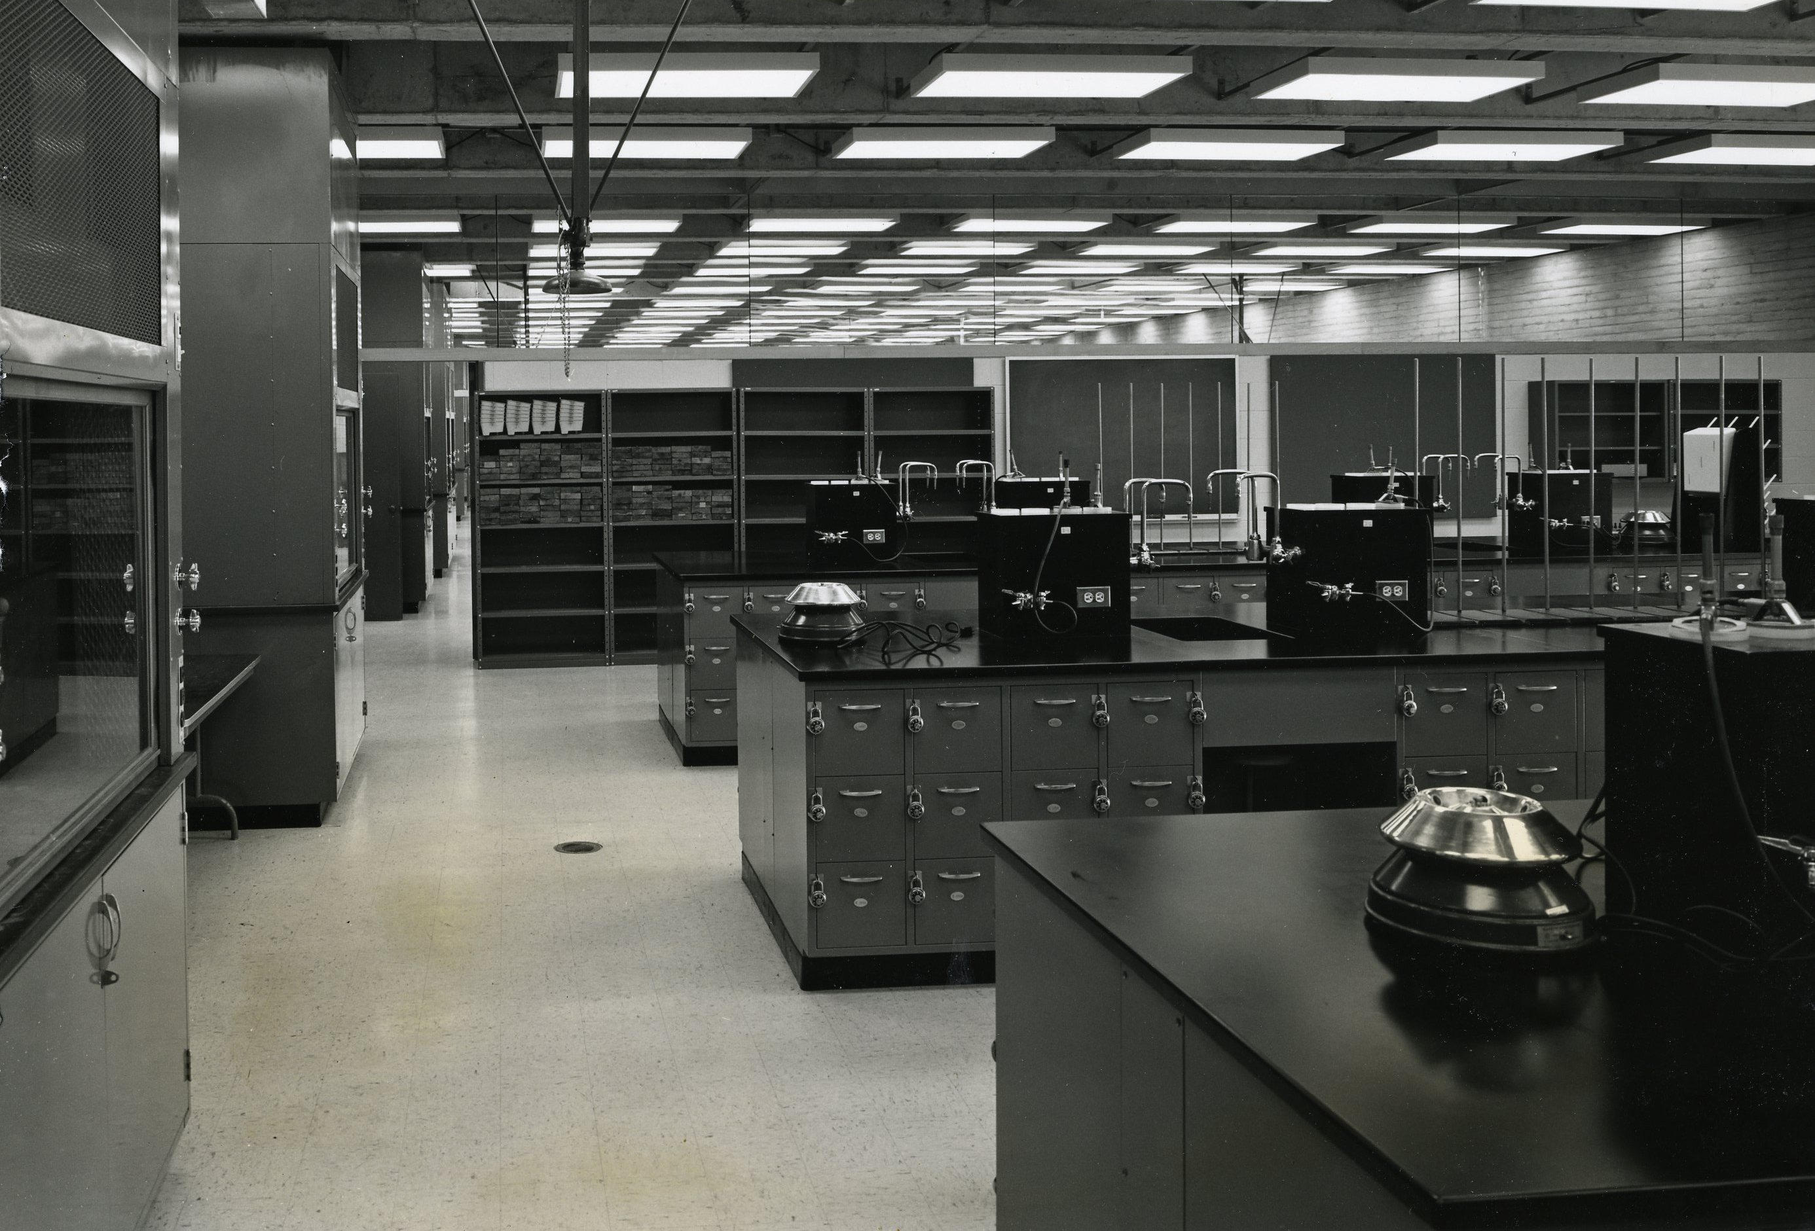
Task design: entity reclassification
Automated generator of reclassification tasks
School Ontology
FOAF Ontology
Student
Person
rdf:type
rdf:type

Slide 10
Design: from tasks to OntoCaptcha
Building a task for OntoCaptcha
Player
Actor
Scientist
Ontology
domain
Control
class

Slide 11
How does OntoCaptcha work?
4 clicks without errors to solve it

Slide 12
How does OntoCaptcha work?
Click to change domain
Context and user aware!
Click to change task

Slide 13
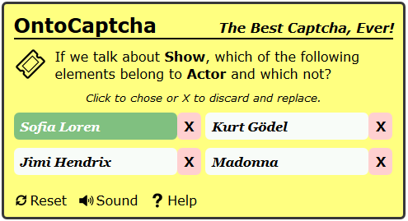
How does OntoCaptcha work?
Click to choose an «actor»

Slide 14
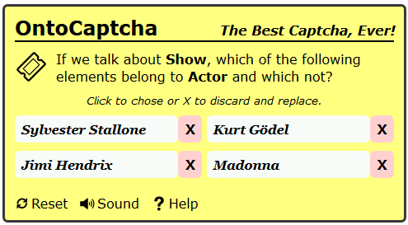
How does OntoCaptcha work?
Options are replaced after being used

Slide 15
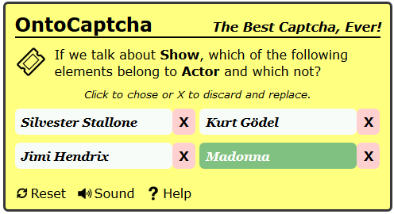
How does OntoCaptcha work?
Positive associations

Slide 16
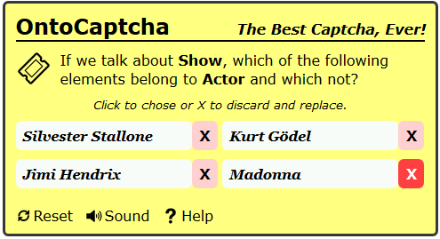
How does OntoCaptcha work?
Negative associations

Slide 17
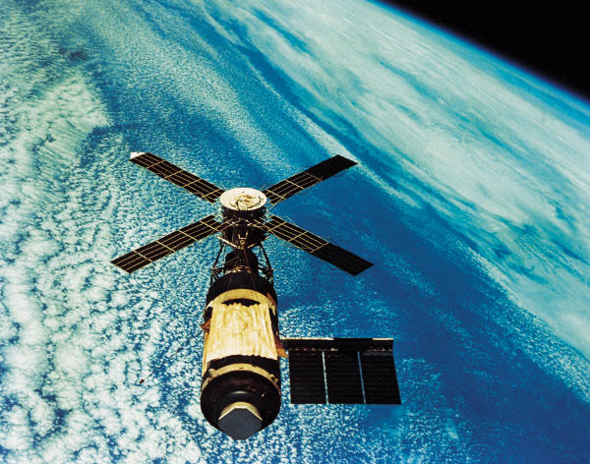
How do we use collected data?
Inferring class relations from task results
- Equivalence
- Disjointedness
- Less general
- Overlap
?
Student
Person

Slide 18
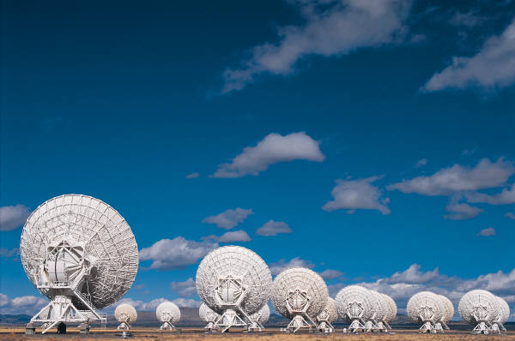


Evaluation
Given a reference alignment R
Precision of an alignment A :
Recall:

Slide 19

Perspective
Generating the next microtask depending on previous answers.
Providing users more information about the context.
Selecting the good users based on their profile and performance history.

Slide 20

Conclusion
Problem: involving people for helping ontology matching
Solution:
- design a captcha tool
- offering simple reclassification tasks
- generated from linked data
- allowing for inferring relations between classes

Slide 21
Conclusion
Problem: involving people for helping ontology matching
Solution:
- design a captcha tool
- offering simple reclassification tasks
- generated from linked data
- allowing for inferring relations between classes
So… tomatoes are vegetables. NO TAX!

